Slide 1

Team D
Alona
Igor
Teresa

Slide 2

An exploration of our Retail Customers

Slide 3
Contents
Main motivation for selecting this dataset (Alona)
Team Matrix (Teresa)
Executive Summary (Teresa)
Customer overview (Teresa)
Bank’s Financial Health – Tableau Dashboard (Igor)
Appendix:
Trello Board
Further analysis opportunities
Customer and bank details in charts

Slide 4

Main motivation for selecting this dataset
Scenario:
A newly appointed Marketing Manager needs to understand the bank’s customer profile to design effective marketing communications.
This dataset was chosen to support that goal by enabling customer segmentation and insight generation.

Slide 5
Team Matrix
 | Teresa | Igor | Alona
PM
GitHub
ReadMe
Trello
Analysis
Tableau
Presentation

Slide 6





Executive Summary
Who are our customers?
Bank’s Financial Health (1991-2021)
Middle-aged
Balanced male/female
Financially healthy
Strong credit scores
Debit cards primary payment method
2010 marked a high point in customer engagement, with peak levels in both total spending and new account openings.
Since 2010, the bank has experienced a consistent decline in both metrics, signalling a long-term shift in customer behaviour and financial activity.

Slide 7

Let’s Meet Our Customers

Slide 8








Infographic: Customer Overview
2,000 Customers
Demographic Profile
Financial Health
49%
51%
Annual Income $40,745 | Credit Limit: $12,595
Credit Score 712/850 | Total Debt $58,250
Youngest | Average | Oldest
18 yrs old | 44 yrs old | 101 yrs old
 |  | X
Retirement age | 66 yrs of age
Bank Cards
Credit Limits
Transactions
 | Overall Use | Brand
Credit | 33% | 39%
Debit | 57% | 62%
Pre-Paid | 9% | 66%
 | Limit
Credit | $10,100
Debit | $16,455
Pre-Paid | $65
 | Limit
Credit | $1,275
Debit | $1,015
Pre-Paid | $380
Base: 2,000 customers; 6,146 cards
Key: Average = Median (i.e. middle value when arranged in order). $ rounded to the nearest $5.
Notes:
Gender balance – across all features – nothing stands out as different e.g. median retirement age is 66 for both males and females
Age – quite distinct:
FICO (Fair Isaac Corporation) scale: Poor: 300-579; Fair: 580-669; Good: 670-739; Very Good: 740-799; Exceptional: 800-850
Spending – Individual transactions higher among younger customers(<30 yrs old) but in terms of total spending

Slide 9
Age is an important predictor of financial health, especially for older groups
Median (Annual) | Young Adults <30 yrs | Emerging Families 31-40 yrs | Established Adults 41-50 yrs | Pre-Retirement 51-60 yrs | Retirement/ Senior Adults 60+ yrs
Income | $44k | $42k | $40k | $41k | $36k
Total Debt | $67K | $65k | $62k | $69k | $16k
Spending | $39k | $46k | $47k | £50k | $48k
Credit Cards | 2 | 3 | 3 | 3 | 4
Credit Score | 711 | 712 | 711 | 708 | 714
Base: 2,000 customers; 6,146 cards
Key: Average = Median (i.e. middle value when arranged in order). $ rounded to the nearest $1k.
Notes:
Yearly Income and Debt – moderate positive correlation i.e. as income increases, total debt tends to grow as well
Total Debt and Age – moderate negative correlation – i.e. older people tend to have less debt
Yearly Income and Age – weak negative correlation i.e. older groups tend to have slightly lower income levels
Yearly income and number of credit cards – no meaningful correlation
Credit rating: all rated Good: 670-739. Credit rating is a strong predictor of Total Debt (chart in back – Poor rating: median debt $65k, Fair: $66k, Good: $54k), Very Good: $54k; Exceptional: $57k
FICO (Fair Isaac Corporation) scale: Poor: 300-579; Fair: 580-669; Good: 670-739; Very Good: 740-799; Exceptional: 800-850

Slide 10

Customer Persona: Young Adult (18-30) Understanding our customers to drive better engagement
Demographics | Financial Health |  | Bank Cards
Age: 23 years old Name: Sarah Career: Junior Data Analyst Retirement age: 66 years of age | Annual income: $43,545 Credit score: 711 Credit limit: $13,160 Total debt: $65,660 |  | Number of credit cards: 1 Credit card brand: Mastercard Number of debit cards: 2 Debit card brands: Visa Debit (chip)
Bank Behaviours & Preferences | Challenges & Pain Points |  | Goals
Mobile banking: Primary Web banking: Secondary Branch: minimal use Telephone customer service preferred | Better control over real-time spending Managing debt with faster paydown or consolidation |  | Financial: Build sold financial foundation Lifestyle: Travel & home ownership
Marketing for Sarah
Message “Help me take control of my finances today while building towards the future I want, free of debt.” |  | Tone & Style Empowering & Supportive Modern & Digital first | Tone & Style Empowering & Supportive Modern Digital first
Base=520 customers
Key: Average = Median (i.e. middle value when arranged in order). $ rounded to the nearest $5.
Notes:
Strong relationship between debt and credit score.
FICO (Fair Isaac Corporation) scale: Poor: 300-579; Fair: 580-669; Good: 670-739; Very Good: 740-799; Exceptional: 800-850

Slide 11
Further Analysis Opportunities
Analysis | Opportunity
Combine Income + Spending + Debt | Product Penetration: Who has the capacity for investment products Which high-income, low-spending customers are underutilising banking services Which customers could benefit from refinancing or debt consolidation
Location-Based Analysis: How Income, Spending and Debt differ by region | Product creation: Personalised local offers Regional strategy
Combine Income + debt [Low risk: high income, low debt] Emerging risk: mid-income, rising debt] High-risk: low income, high debt] | Risk and Financial Health Profiling: Design programmes for credit improvement Safe spending guidance Product recommendations aligned to risk

Slide 12
Bank’s Financial Health

Slide 13
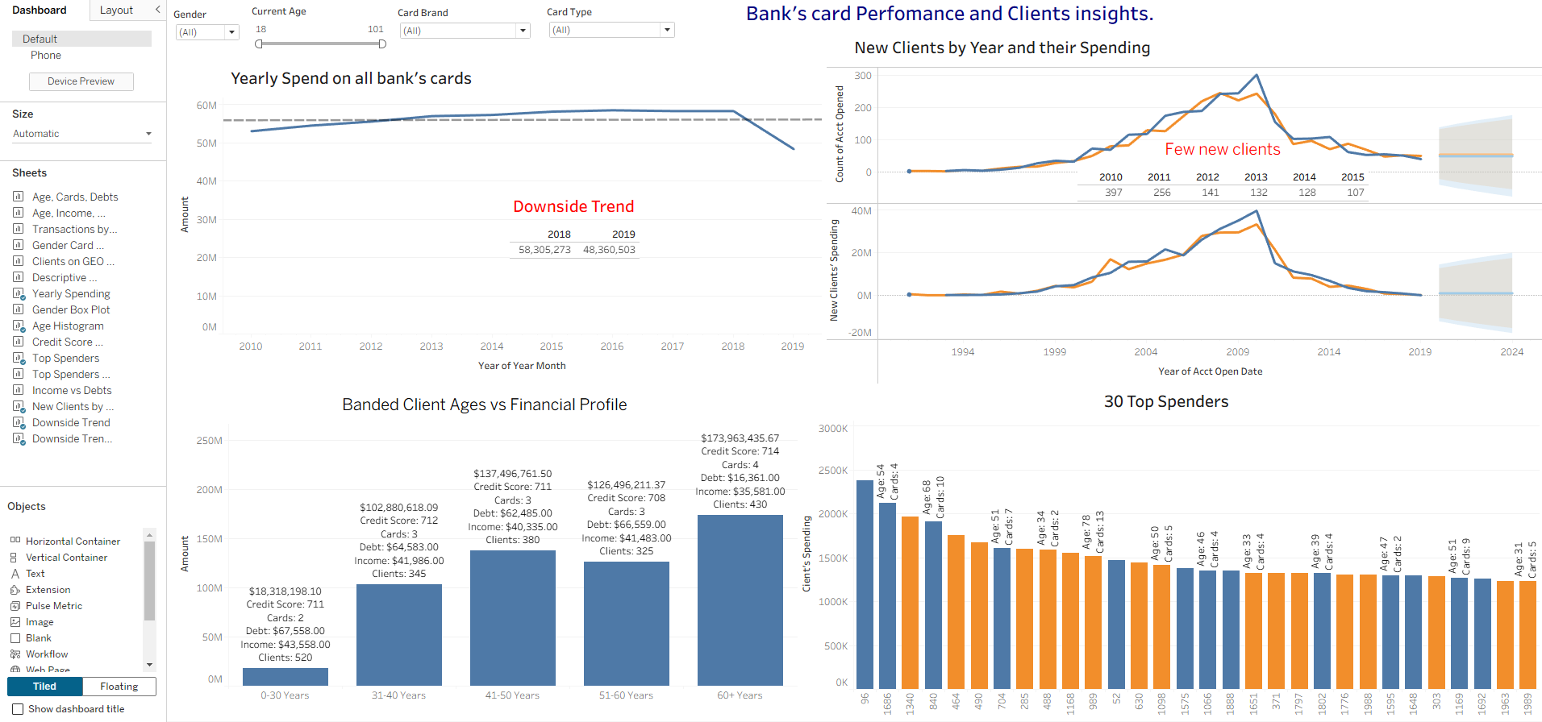
Dashboard: Card Performance and Clients’ Insights

Slide 14
Appendix

Slide 15
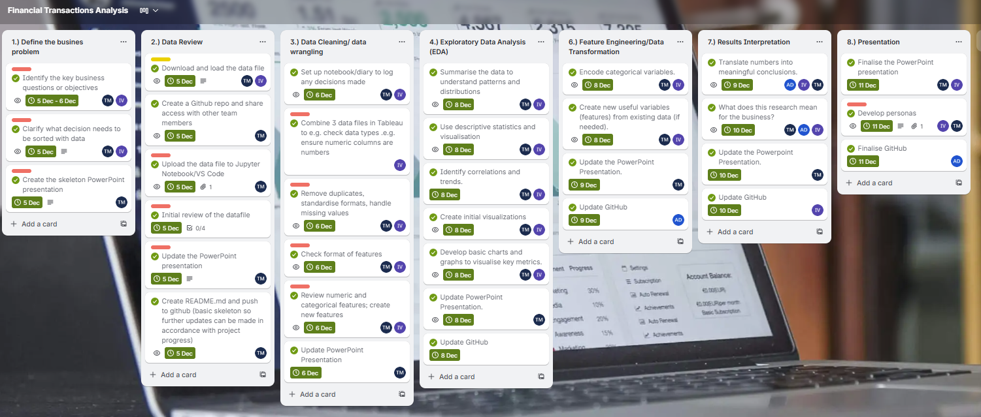
Trello Board

Slide 16
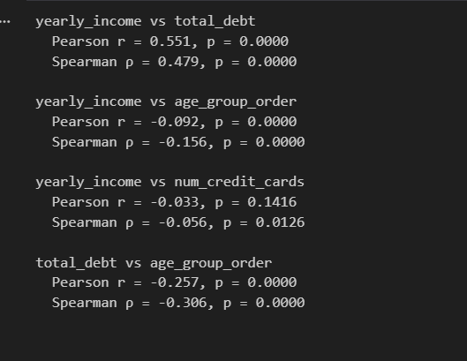
Analysis Debt, Income, Age
Yearly Income and Debt | Moderate positive correlation – as income increases, total debt tends to grow as well. Higher earners may carry more debt.
Yearly Income vs Age | Weak negative correlation – older groups tend to have slightly lower income
Yearly Income vs Number of Credit Cards | No meaningful correlation
Total debs Vs Age | Moderate negative correlation – older individuals tend to have less debt

Slide 17
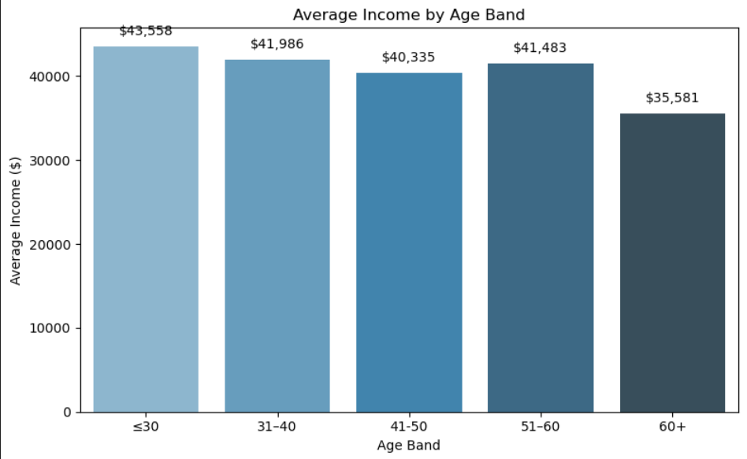
Average Income is lowest among those over 60

Slide 18
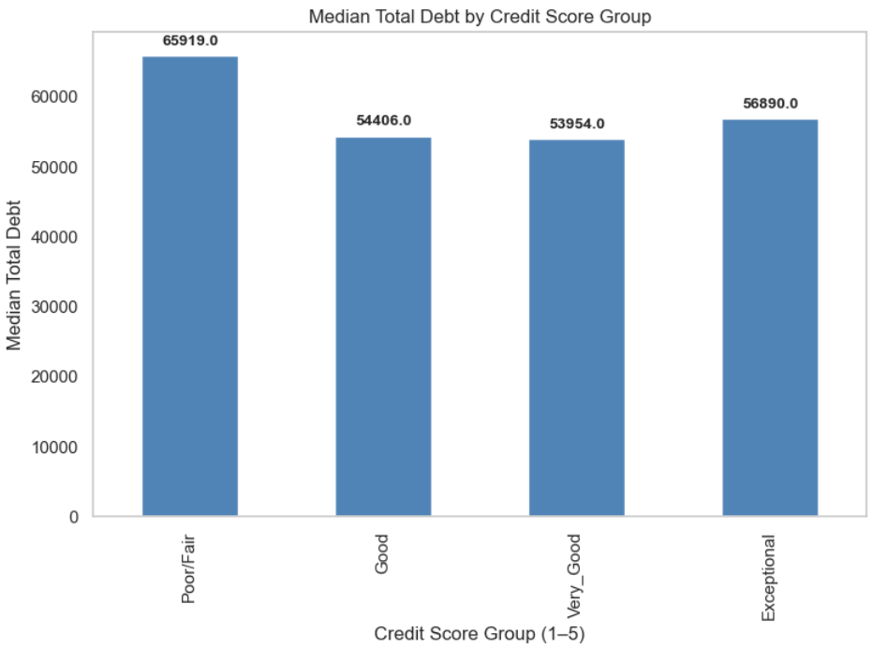
Credit score is a strong predictor of debt levels.
Base: Poor/Fair: 429; Good: 931; Very Good: 474; Exceptional: 166

Slide 19
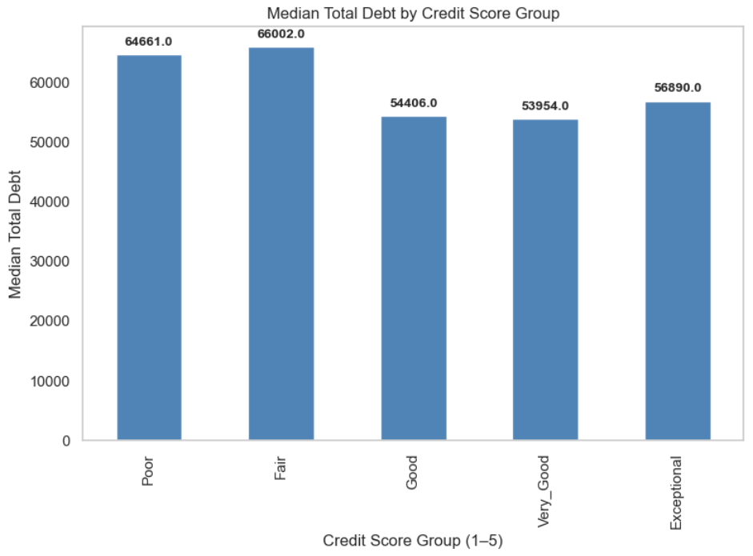
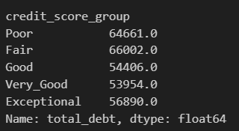
Median debt is highest among low credit score groups but rises again for the most credit worthy
Base: Poor: 81; Fair: 348; Good: 931; Very Good: 474; Exceptional: 166

Slide 20
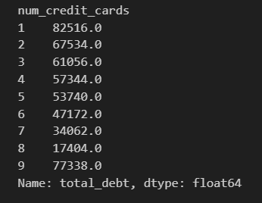
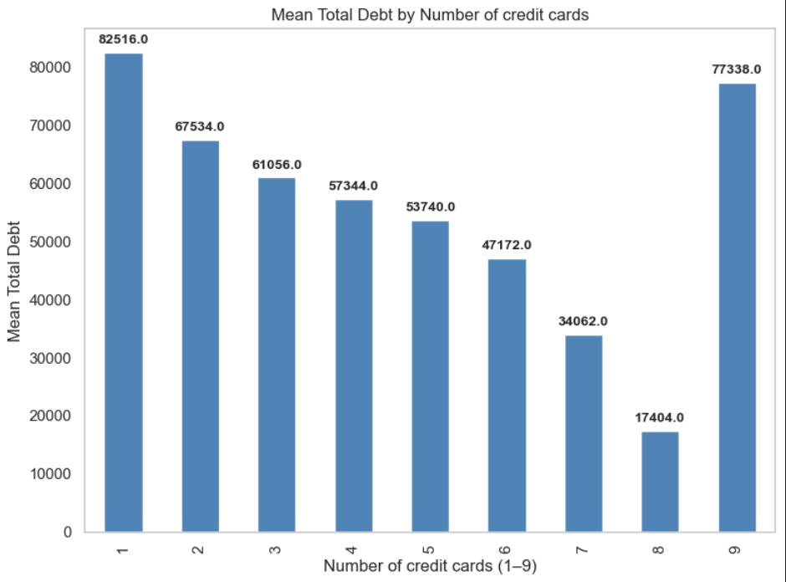
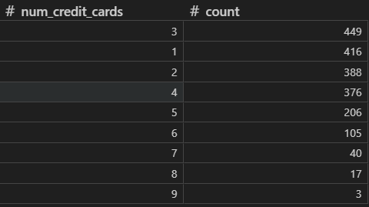
Quite a range of credit cards. Recommendation to band those who hold 5 or more credit cards.

Slide 21
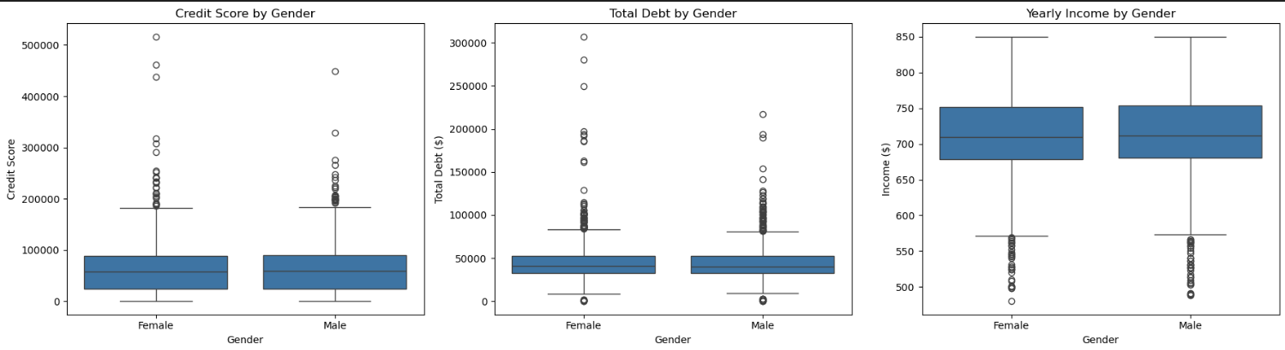
There is parity in terms of gender by credit score

Slide 22

Credit Score: FICO Score
https://www.fico.com/
Score Range (300-850) | Category | Meaning
300–579 | Poor | High risk; often denied credit or offered very high interest rates
580–669 | Fair | Subprime borrowers; may qualify for credit but with less favourable terms
670–739 | Good | Generally acceptable to most lenders; moderate interest rates
740–799 | Very Good | Strong credit profile; access to better rates and terms
800–850 | Exceptional | Top tier; best borrowing terms, lowest interest rates
Fair group has sig higher debt than Exceptional group. No differences among other group
Notes:
Fair Isaac Corporation (FICO) → Founded in 1956, it developed the scoring system that became the industry standard.
FICO Score → A credit score based on information in your credit reports, used by banks, credit card issuers, and other lenders to assess risk.
Range → Usually 300–850, with higher scores indicating lower credit risk.
FICO scores are built from five weighted factors:
Payment history (35%) – on‑time vs late payments.
Amounts owed (30%) – how much of your available credit you’re using.
Length of credit history (15%) – how long you’ve had accounts.
Credit mix (10%) – variety of credit types (cards, loans, mortgages).
New credit (10%) – frequency of new applications.

Slide 23
Customer Overview
 | Customer Statistics
2,000 customers | Range(min-Max) | 25% | Median | 75%
Age | 18-101 years of age | 30 | 44 years of age | 58
Retirement age | 50 – 79 years of age | 65 | 66 years of age | 68
Per capita income | $0 – $163145.00 | $16824.5 | $20,581 | $26286
Yearly income | $1-$307018.00 | $32818.5 | $40,745 | $52,698.5
Total debt | $0 - $516263.00 | $23986.75 | $58251.0 | $89070.50
Credit score | 480-850 | 681 | 711.5 | 753
Number of credit cards | 1-9 cards | 2 | 3 | 4
Notes:
Gender balance – across all features – nothing stands out as different

